Slide 1
PA Compression Test Software Conference Call – M/A-COM
Nick Lalic
VNA Software Developer
Cupertino, CA
December 3rd, 2015

Slide 2
PA Compression Test
Feedback from Greg:
Fit settings page to ZVA screen
“Inner loop” progress bar
Show increasing power on progress plot
Take into account input attenuators
Consider replacing linear interpolation with… ?
Repeatability, accuracy of results?
ALC?
Feedback from M/A-COM:
Why is it slower?
Add power sweep option
Export all data to single CSV file
Change plots without resweeping
Thermal drift in current VNA results display?
Pulsed CW?
Other requests? …Need help interpreting other M/A-COM comments

Slide 3
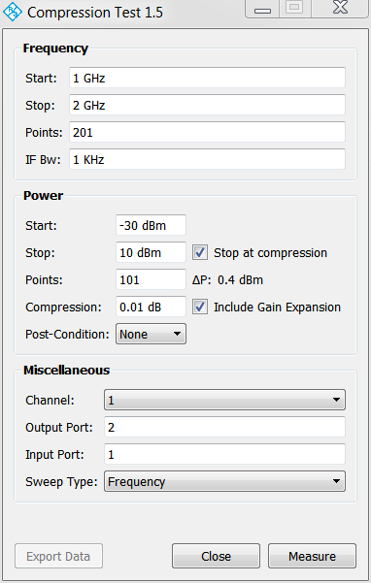
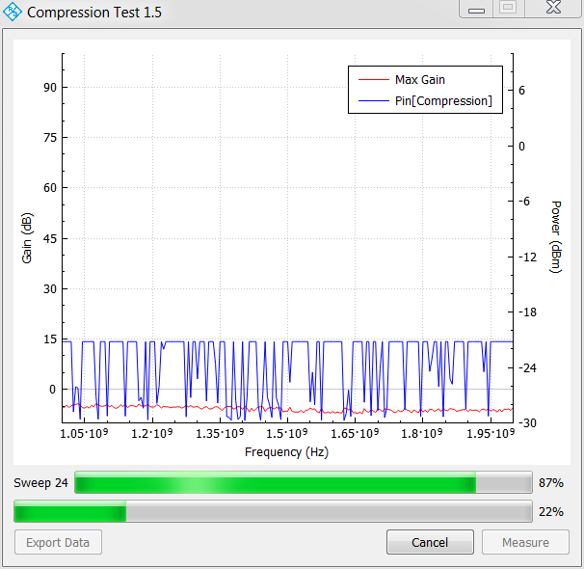
Graphical User Interface
Settings Page
Progress Page

Slide 4
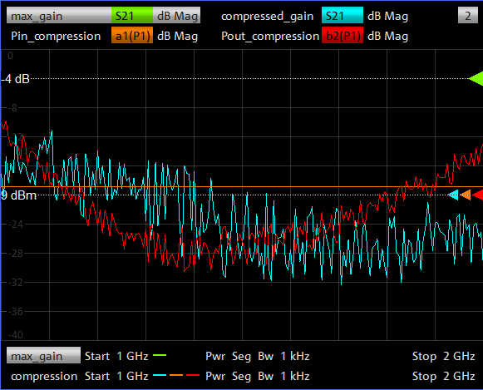
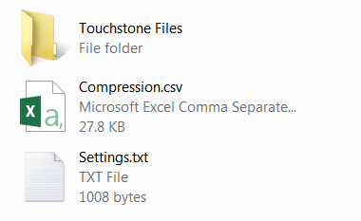
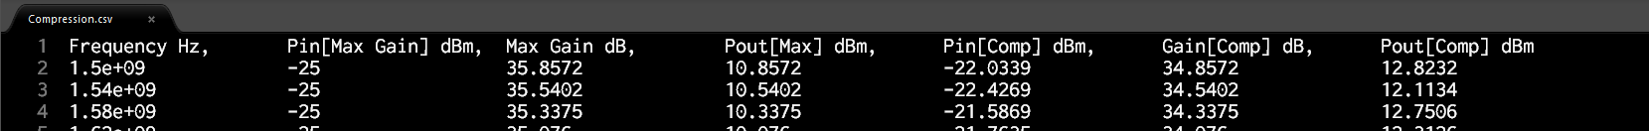
Results
VNA Display:
Max Gain
Compressed Gain
Pin_Compression
Pout_Compression
Exported Data

Slide 5
Block Diagram
Is this workflow still sufficient?
Settings Page
Progress Page
to
VNA
to
File
Updates
Measurement
Settings
Measure
Thread
(Multiple Types)
Measurement
Data
Step 1
Step 2
Step 3

